Slide 1
Future finance masterclass

Slide 2
Session one: Why your finance team is leaving and what you can do to stop it

Slide 3
Future finance masterclass
Workshop dates
25 October 14:30 BST/9:30 am EDT
Why your finance team is leaving and what you can do to stop it
People
15 November 14:00 BST/9:00 am EDT
What the CFO wants to see and why it's not happening
Process
Systems
6 December 14:00 BST/9:00 am EDT
The essential tools every finance team needs in 2023

Slide 4
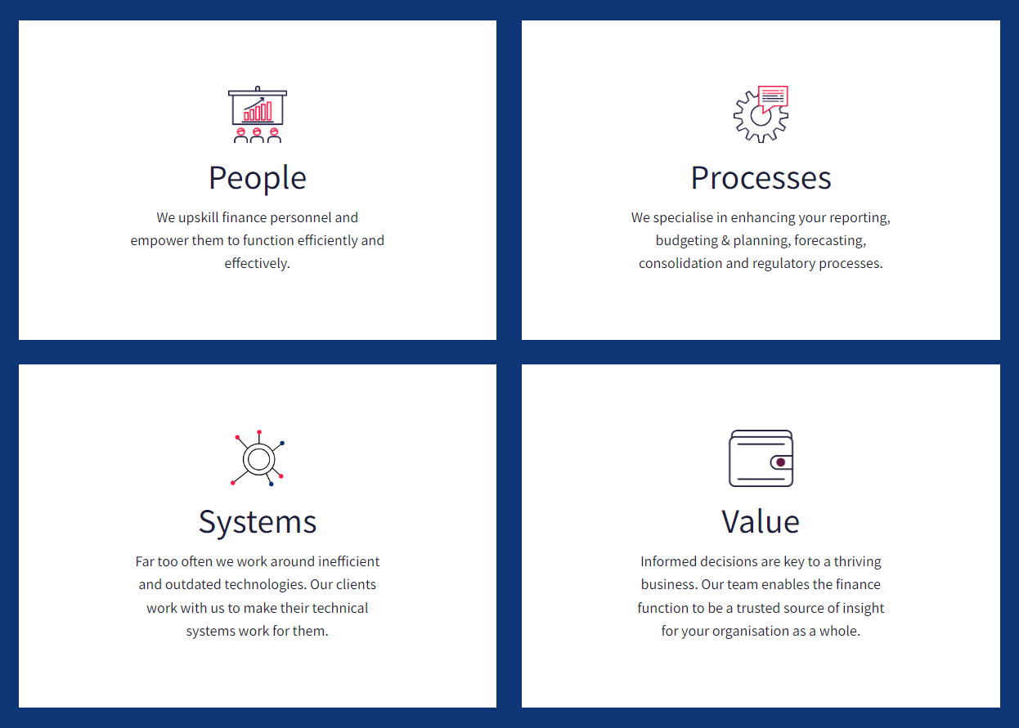
Future finance masterclass

Slide 5
Our panel
Jan Schwarz
Co-Founder
Visier
John Fuggles Partnership Manager
VantagePoint
Dav Masaon
Founding Partner
Zanda

Slide 6
How data and analytics can influence your retention strategy
Jan Schwarz – Co-Founder, Visier

Slide 7
Visier
Visier is clearly the market leader in end-to-end people analytics solutions
Josh Berson, Global Industry Analyst
The leader in people analytics
12 million+
employee records
Richest collection of anonymized employee data to manage change
2000+
business metrics
Most impactful coverage of people analytics in the market
15000+
customers
Industry leaders in technology, financial services, healthcare and life sciences
Leader and market outperformer in GigaOm Radar for People Analytics Platform
Ranked #1 in market share for Workforce Analytics Applications
Leader and market outperformer in GigaOm Radar for People Analytics Platform

Slide 8
Where do you begin?
Priorities and business issues
Talent Acquisition Talent Retention Learning Effectiveness Diversity & Inclusion Headcount Costs Workforce Planning Spans & Layers Workforce Productivity Contingent Labor Leadership Development Sales Training Employee Skills Analysis Historical Headcount Workforce & Headcount Cost Employee Turnover Employee Profile and Compensation Employee Movement Safety Case Management Employee Relations Hourly Workforce Staff Deployment Overtime Absenteeism | Employee Starts & Exits Employee Diversity Employee Demographics Crisis Management HR Effectiveness Benchmarks Applicant Pipeline Sourcing Quality of Hire Diversity Hiring Process Campus Recruiting Recruiter Capacity Candidate Experience Retention & Retirement Retention Budgeted Compensation Employee Performance Employee Mobility Engagement Headcount Projections Business Results Actual Compensation Network Impact Employee Experience Leadership & Succession | Leave & Risk Management Employee Case Management Employee Recognition Sales Attainment Learning Impact Learning Operations Learning Engagement Compliance Learning New Hire Programs Leadership Development Sales Training Employee Skills Analysis Historical Headcount Workforce & Headcount Cost Employee Turnover Employee Profile and Compensation Employee Movement Safety Case Management Employee Relations Hourly Workforce Staff Deployment Overtime Absenteeism Attendance Patterns Individual Production
Which approach saves time, minimises risk and reduces costs?
The uncertainty and risk of data and analytics
What are the most important questions to ask?
How do I maximise the business impact?

Slide 9
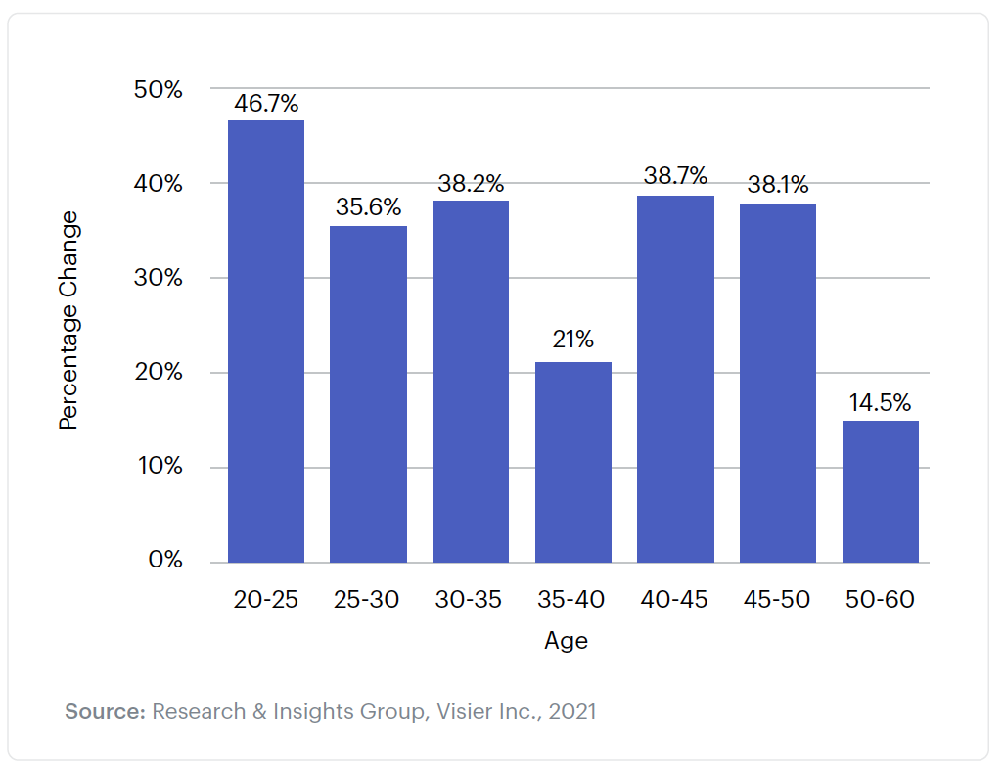
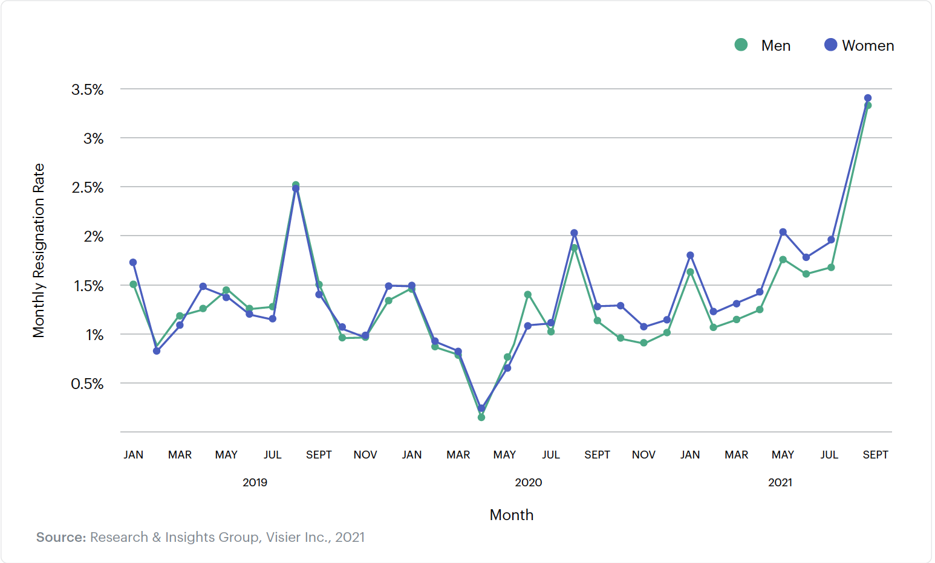
Trends and demographics behind the resignation wave
Tenured experienced professionals, and more women than men, show a dramatic increase in resignations compared to the pandemic-ridden year 2020.
Employees across tenures are leaving (50%+ increase in resignation rate 0-15% tenure 2020 vs 2021)
Mid-career professionals resign at high rates (chart a: increasing their resignation rates by over 38% 2020 vs 2021). More experienced employees are rethinking their work situation
Resignation rates are higher for women (chart b: 55.4% growth for women, 47.2% growth for men in 2021) and growing.
Chart a.
Chart b.

Slide 10
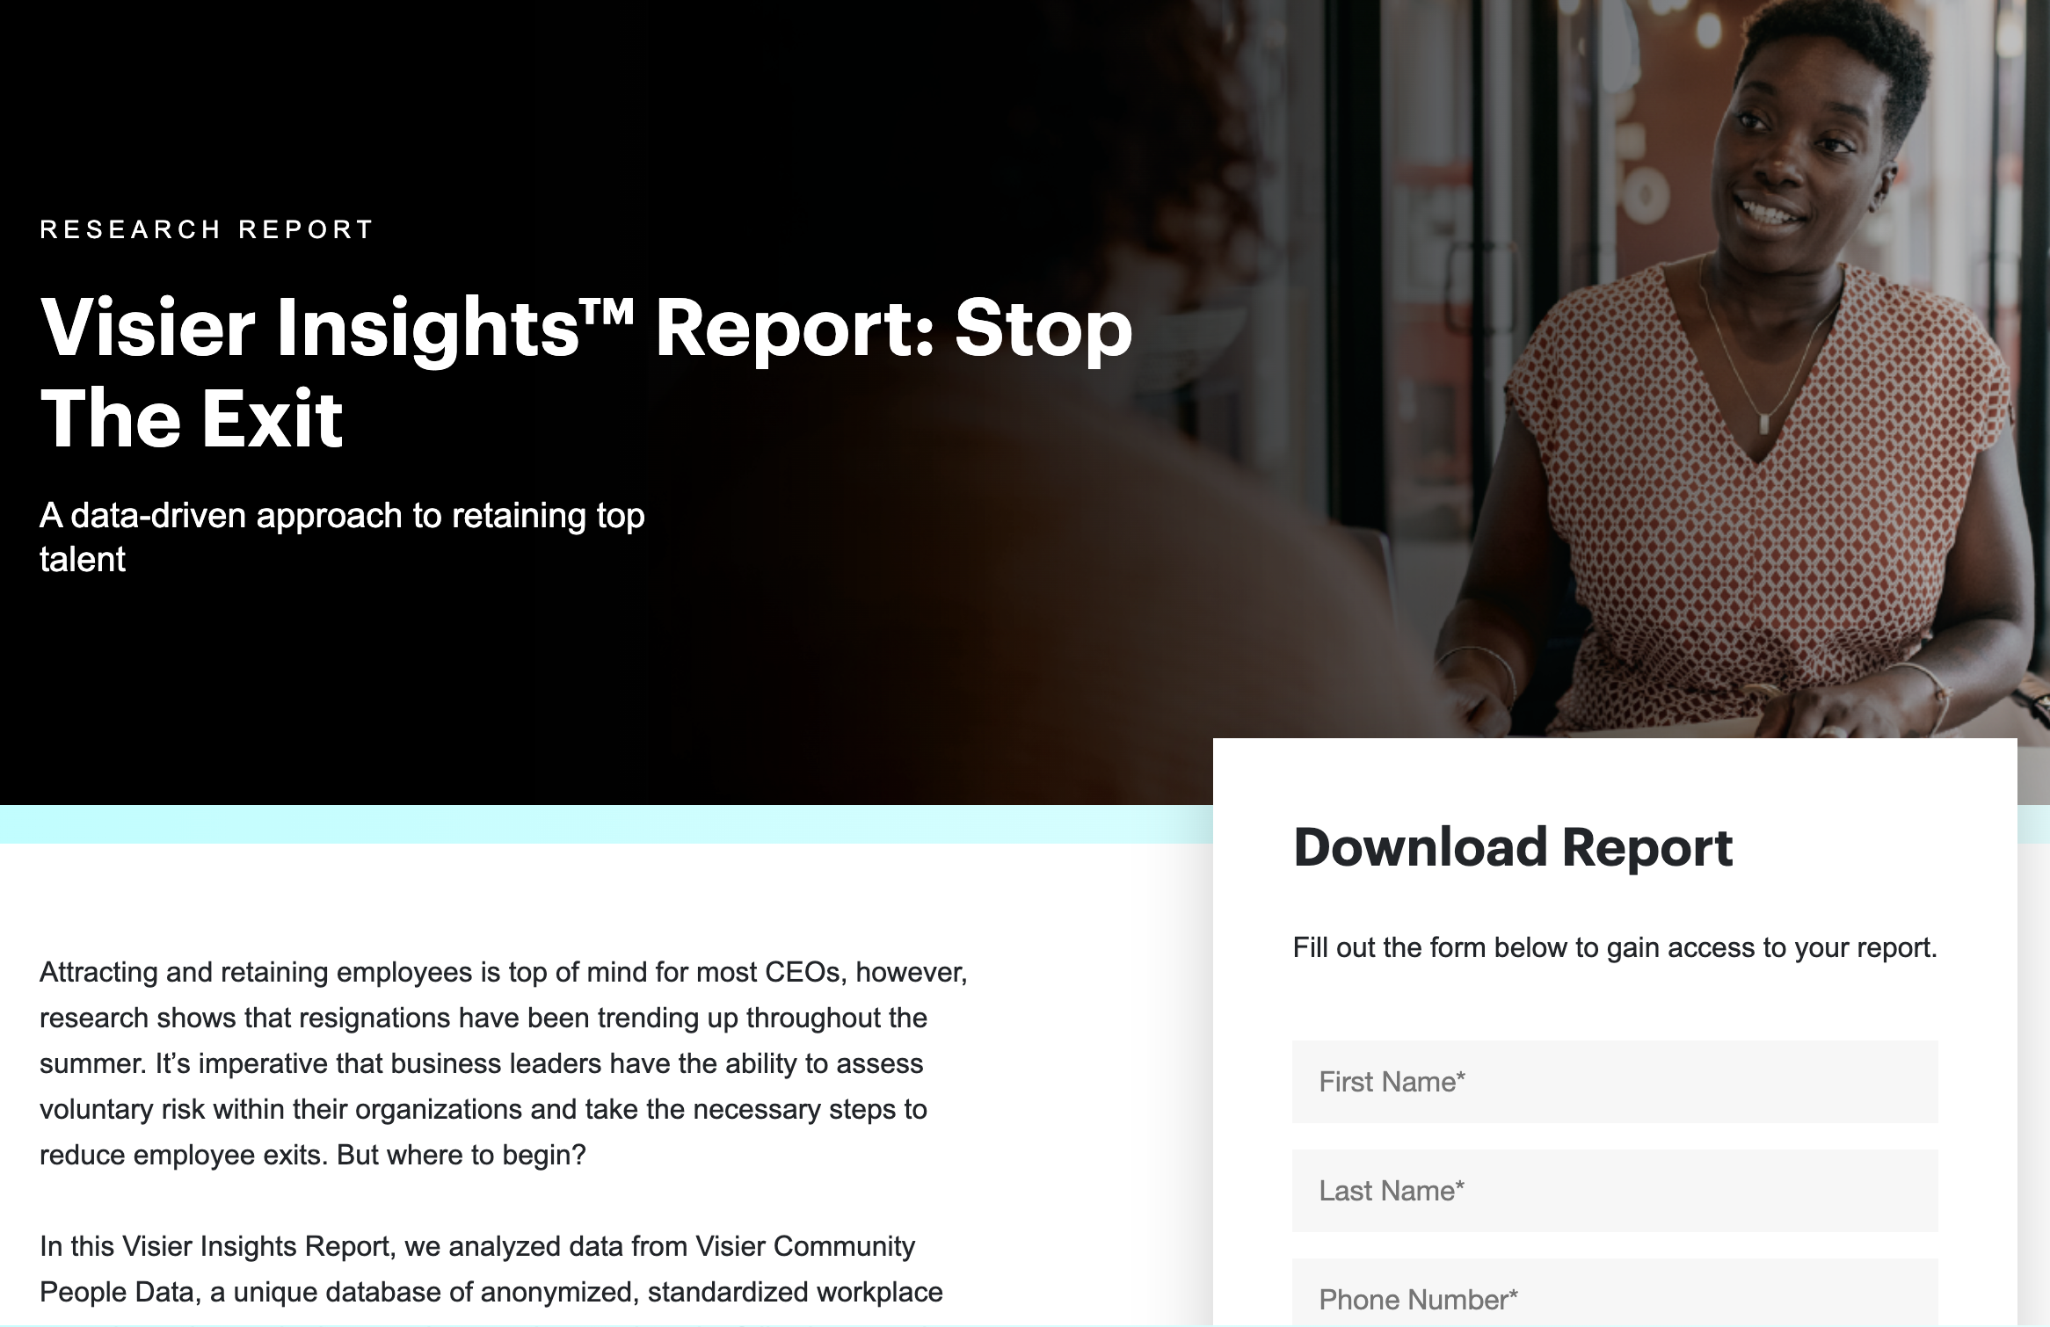
Why employees are leaving their jobs
Recognition
Burnout
Workplace
culture
SHRM¹⁵ lists the following drivers as the leading reasons behind resignations by employees:
The desire for better compensation and benefits
The need for better work-life balance
A lack of recognition for the work they do.
DDI recently found that employees in leadership roles in particular are at risk due to burnout.¹⁶ Similarly, a recent Visier¹⁷ survey revealed burnout, a key driver for voluntary turnover, can be fueled by:
Being asked to take on more work
A toxic workplace culture
Being asked to complete work faster.
Gallup indicated that the current resignation rate is an effect of “workplace issues” linked to lack of engagement or even active disengagement.¹⁸
Reasons for resignation rates are plentiful, not at least in the past 18 months where the COVID-19 pandemic began to change peoples’ mindset about how and where they want to work.
14
14 npr.org/2021/06/24/1007914455/as-the-pandemic-recedes-millions-of-workers-are-saying-i-quit
15 shrm.org/hr-today/news/hr-magazine/summer2021/pages/reducing-turnover.aspx
16 ddiworld.com/about/media/glf-2021
17 visier.com/clarity/new-survey-70-percent-burnt-out-employees-would-leave-current-job/
18 gallup.com/workplace/351545/great-resignation-really-great-discontent.aspx
https://hello.visier.com/stop-the-exit-report.html

Slide 11
How to retain top accounting and finance talent
Dav Masaon – Founding Partner, Zanda

Slide 12
How to retain top accounting and finance talent
If your employees aren’t happy, they’re going to go somewhere else. Given the high levels of job vacancies within accounting and finance, that won’t be hard. It’s also an issue that is getting worse, with 75% of all CPAs expected to retire in the next fifteen years.
You probably heard of it or dealt with it – “The Great Resignation”, as many baby boomers retire early and millennials and Gen-Zers look for jobs with greater degrees of flexibility and highly competitive compensation packages. The finance and accounting (F&A) sector has certainly been impacted.
In fact, the employee shortage is coming at a time when the need for strong talent in the F&A field is steadily increasing. According to the Bureau of Labor Statistics, the demand for accountants is forecast to grow 7% from 2020 to 2030.
In the face of these headwinds, how can firms retain and acquire the talent required in their evolving F&A departments? Technology and employee engagement are key drivers of these initiatives.

Slide 13
Employee retention strategies
Professional advancement
Filling workforce gaps
with technology
The strategic case for
higher value work
Placing a premium on
employee engagement
Create professional advancement and professional development opportunities. Keep in mind that “advancement” can mean promotions, but this may not be possible in smaller offices. An ideal situation would be to have tangible advancement goals and regular evaluations that would give employees the chance to advance.
As competition for skilled employees continues at a fever pitch, increasing compensation packages and benefits will only go so far in meeting many firms’ workforce support needs. Combining a proactive talent acquisition and retention program with critical and strategic investments in technology can help ensure levels of support both now and in the future. In fact, technology investments can also de-risk firms from potential future volatility in workforce availability.
Beyond filling critical hiring gaps, leveraging automation technology can help both existing team members and new hires focus on higher-value work. This enables employees to elevate their skills, engage in more value-add activities and support strategic objectives in more meaningful ways.
Though work-from-home or hybrid models are attractive to employees who enjoy greater flexibility, many workers reported feeling less connected to their employers. Companies will need to make more of an effort to foster a sense of belonging among workers who might not meet regularly in person.

Slide 14
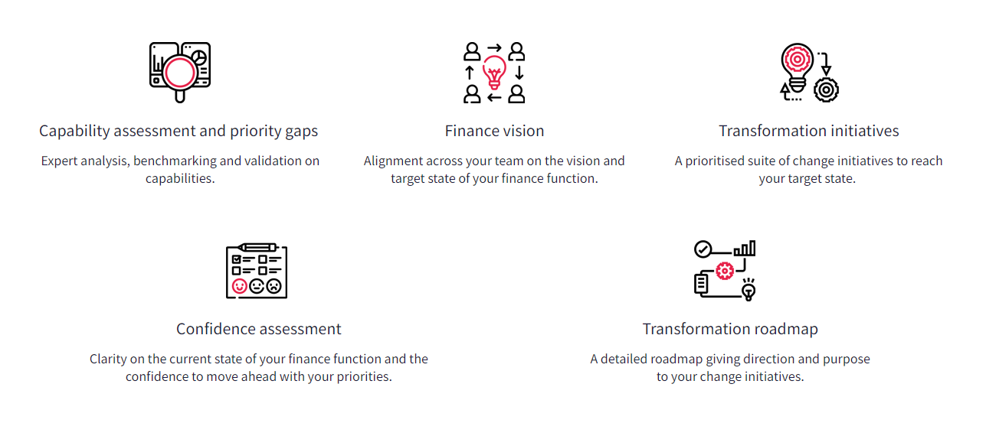
CFO Labs by VantagePoint
Elevate your finance function by creating a connected finance strategy in one day

Slide 15
Q&A

