Slide 1
Future finance masterclass

Slide 2
Session three: Essential tools your finance team needs in 2023

Slide 3
Future finance masterclass
Workshop dates
25 October 14:30 BST/9:30 am EDT
Why your finance team is leaving and what you can do to stop it
People
15 November 14:30 GMT/9:30 am EST
The CFO's blueprint for fixing broken processes
Process
Systems
6 December 14:30 GMT/9:30 am EST
Essential tools your finance team needs in 2023

Slide 4
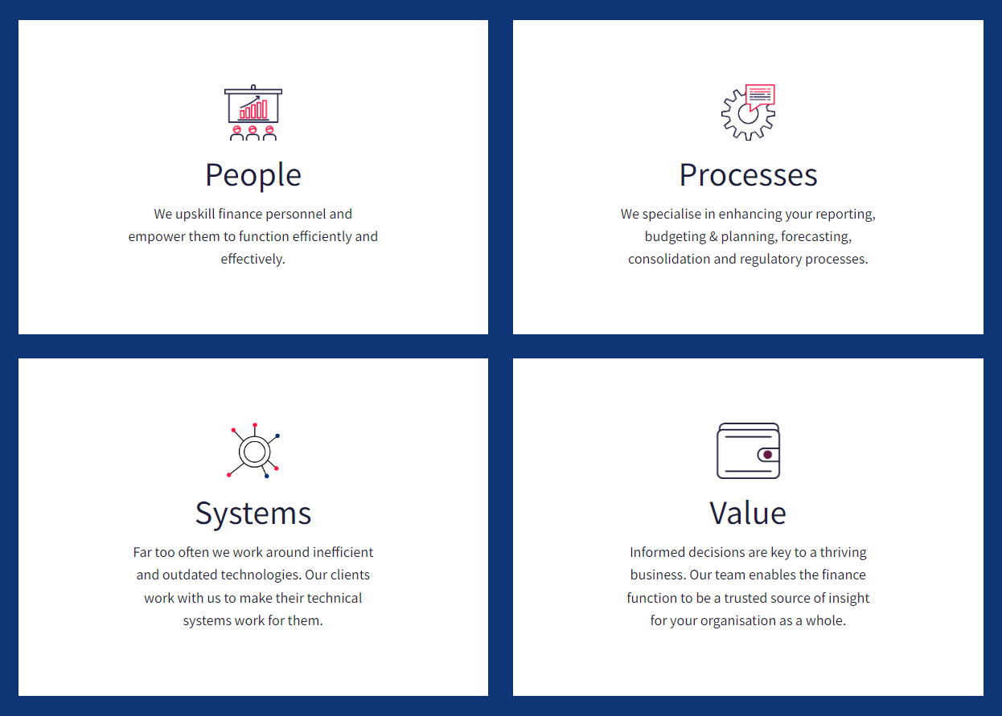
Future finance masterclass

Slide 5
Our panel
Laurence Krieger
Digital Banking CEO & Fintech Advisor
John Fuggles Partnership Manager
VantagePoint
Adil Rehman
Consulting Director
VantagePoint

Slide 6
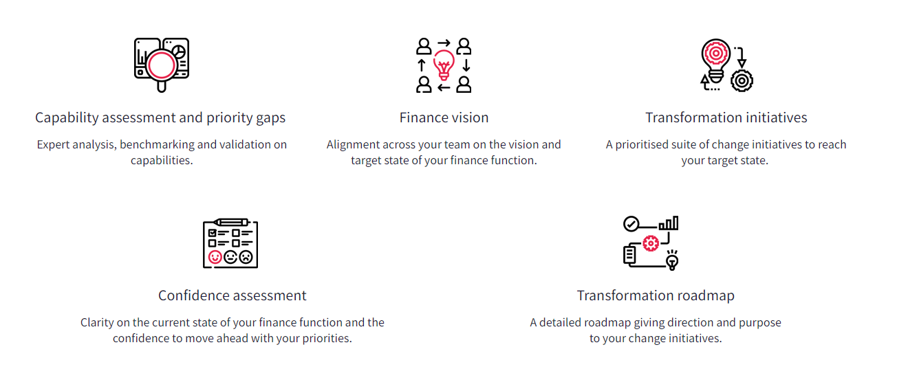
CFO Labs by VantagePoint
Elevate your finance function by creating a connected finance strategy in one day

Slide 7
Q&A

Slide 8
Essential tools your finance team needs in 2023
Adil Rehman – Consulting Director

Slide 9
Pillars of review and metrics
Defining your critical measures as a part of an overall competency framework.
Vision
Process
Effectiveness & Robustness
Definition & Clarity
Approval & Sign-Off
Auditability
Precision & Accuracy
Timeliness
Analyse
Technical Skills
Functional Skills
Governance Structures
Accountability Matrix
Progression & Development
Decision-making
People & Teams
Define
Finance Systems Landscape
Integration
Data to Business Insight
Reporting and Output
Data Quality/ Integrity
Future-proofed solutions
Technology
Deliver
Culture
Ways of Working
Principles & Values
Motivation
Goals & Objectives
Cross Functional Communication
Reporting Structure

Slide 10
Typical Technology journey for Finance
Most organisations go through a similar technology journey and will have common objectives that supported through the delivery of the right technology
Speed to insight - priority for 2023
Excel reliance
Enhanced budgeting / reporting platform
Operations/ Front end system
ERP System implemented
Book keeping software
CRM system implemented
01
02
03
04
05
Technology journey begins
Stable technology base
Industry specific software
Cloud tech / Addition of supplementary partners

Slide 11
Key objectives for your systems in 2023
What should you be receiving from your finance technology stack in 2023
01
02
Scalable technology architecture
01
Speed to Insight
03
04
Advanced Modelling
Automation of processes

